Slide 1
Project Presentation of Full Stack Engineering Project (22CS037)
On
BarterHive
Khushi– 2210991795
Kashish Sharma – 2210991770
Kartikay Singh Manhas – 2210991761
Supervised By
Mr. Rahul
Department of Computer Science and Engineering,
Chitkara University, Punjab

Slide 2
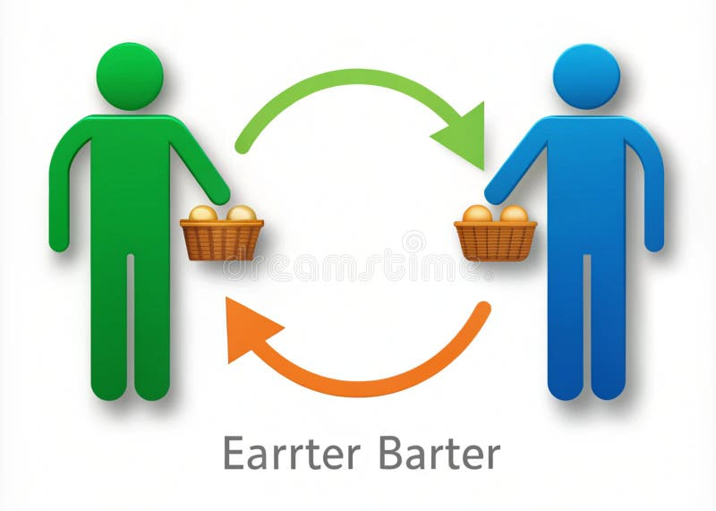
Introduction
The main aim of BarterHive is to create a platform where people in the same community can easily exchange what they have for what they need. Using the MERN stack, the platform offers an easy-to-use interface with features like location-based matching, a system for building trust, the ability to trade multiple items at once, and real-time chats for smooth negotiations.
2

Slide 3
Problem Statement
In modern communities, many individuals have surplus goods or unused skills that go
underutilized due to a lack of a structured platform to facilitate exchange.
1
Inefficient Barter Processes
2
Lack of Clear
Communication
Currently, the process of finding someone to exchange goods or services with is time-consuming and often unreliable. Users need a simple way to connect and negotiate exchanges easily.
Many barter transactions fail due to poor communication between users, leading to misunderstandings about what is being exchanged.
3
Limited Visibility of Items or Services
Users often don’t know what others in the community have to offer, making it difficult to find suitable barter items or services nearby.
3

Slide 4
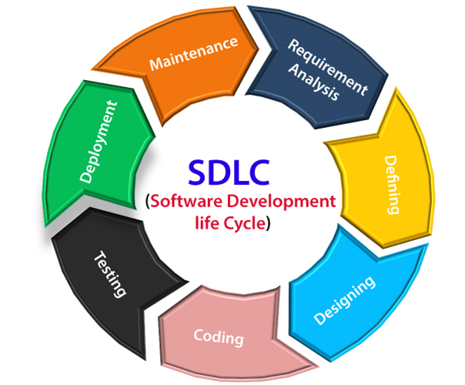
SDLC MODEL

Slide 5
Key Features
1
User Registration and Profile Management
3
Chat System
Real-time chat using WebSockets (e.g., Socket.io) for negotiation
Allow users to register and set up profiles with their skills, services, or items available for barter.
Include location-based search for nearby users.
.
4
Reputation and Review System
Allow users to rate each other after every successful barter.
Display reputation scores and reviews on profiles.
2
Advanced Barter
Matching Algorithm
5
Transaction History and
Status Tracking
Match users based on:
Offered items/services.
Requested items/services.
Proximity (location-based matching).
Users can view completed, ongoing, or declined barter requests.
Provide transaction filters by date, category, or user.
5

Slide 6
Key Features
6
Multi-Item Barter Requests
8
Community Forum
A space where users can discuss barter tips, upcoming events, or share success stories.
Users can offer or request multiple items/services in a single barter.
Include a feature to view detailed exchange summaries.
9
Push Notifications and Alerts
Notify users about barter request updates, new matches, and incoming messages.
7
Dispute Resolution System
Introduce a mechanism where users can raise disputes for incomplete or unfair exchanges.
Admins can mediate based on transaction and chat history.
10
Admin Dashboard
For managing reported users, disputes, and ensuring smooth functioning of the platform.
6

Slide 7
Technical Details
Frontend
Backend
The frontend is developed using React, a popular JavaScript library for building user interfaces. React's component-based architecture allows for efficient development and maintainability.
The backend is powered by Express.js, a fast and minimalist web framework for Node.js. Express.js provides a flexible foundation for building APIs and handling server-side logic.
Database
MongoDB, a NoSQL database, is used to store and manage data, including user information, profiles, and records.
7

Slide 8
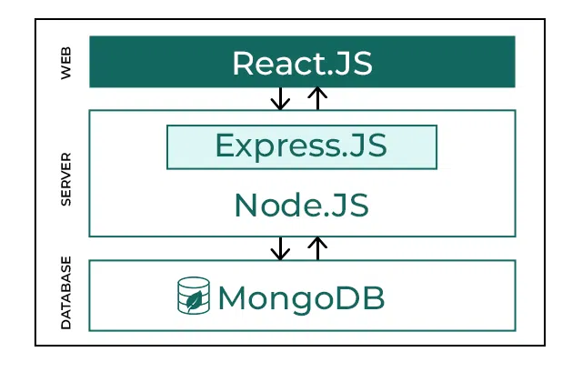
Technologies Used
8

Slide 9
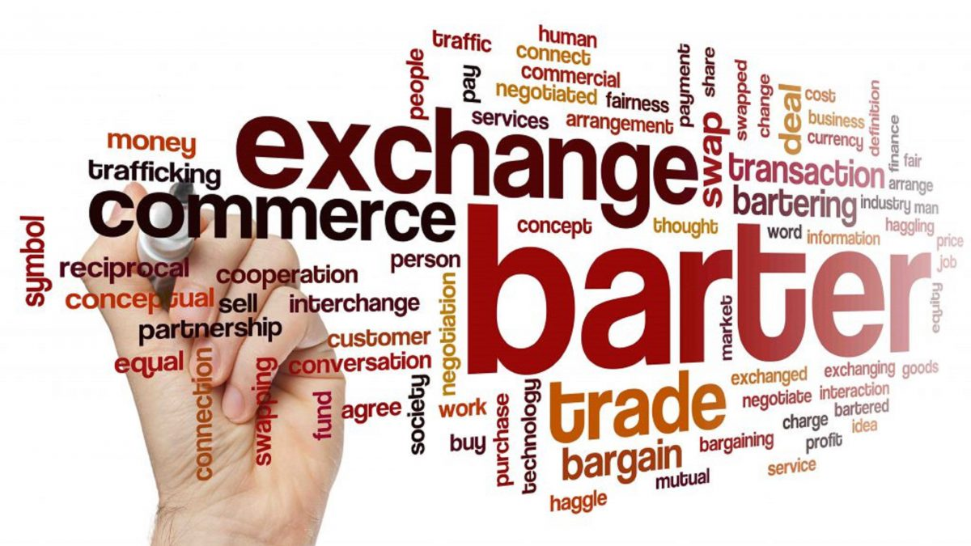
Conclusion
The BarterHive aims to revolutionize the way individuals in a community exchange goods and services by providing an efficient, secure, and user-friendly platform. Through advanced matching algorithms, secure transaction tracking, and real-time communication tools, the project seeks to eliminate traditional barriers like trust issues, manual search processes, and limited visibility.

Slide 10
Thank You
10

